Slide 1

Object Detection
iOS App

Slide 2
Key Highlights
An iOS app capable of detecting objects in images.
Integrated Google Firebase Authentication to ensure only authorized users can access the app.
The following slides showcase the app's user interface and example images.

Slide 3
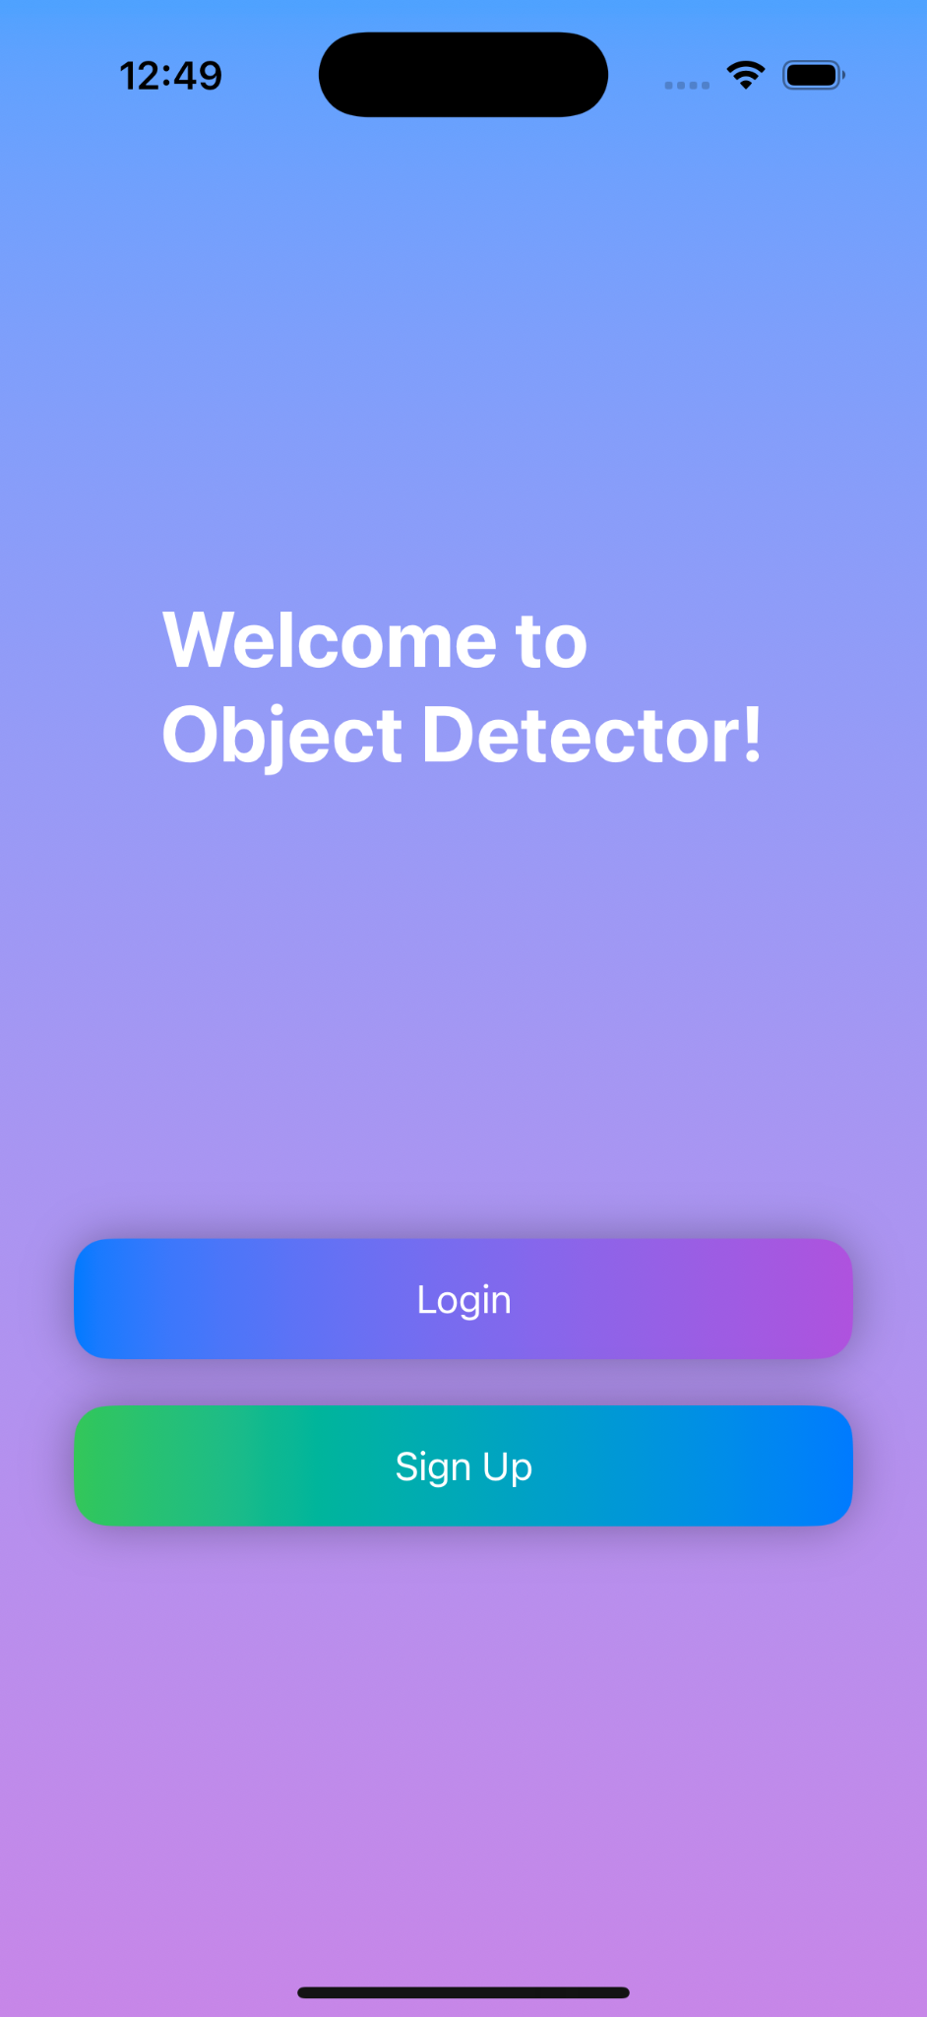
UI

Slide 4
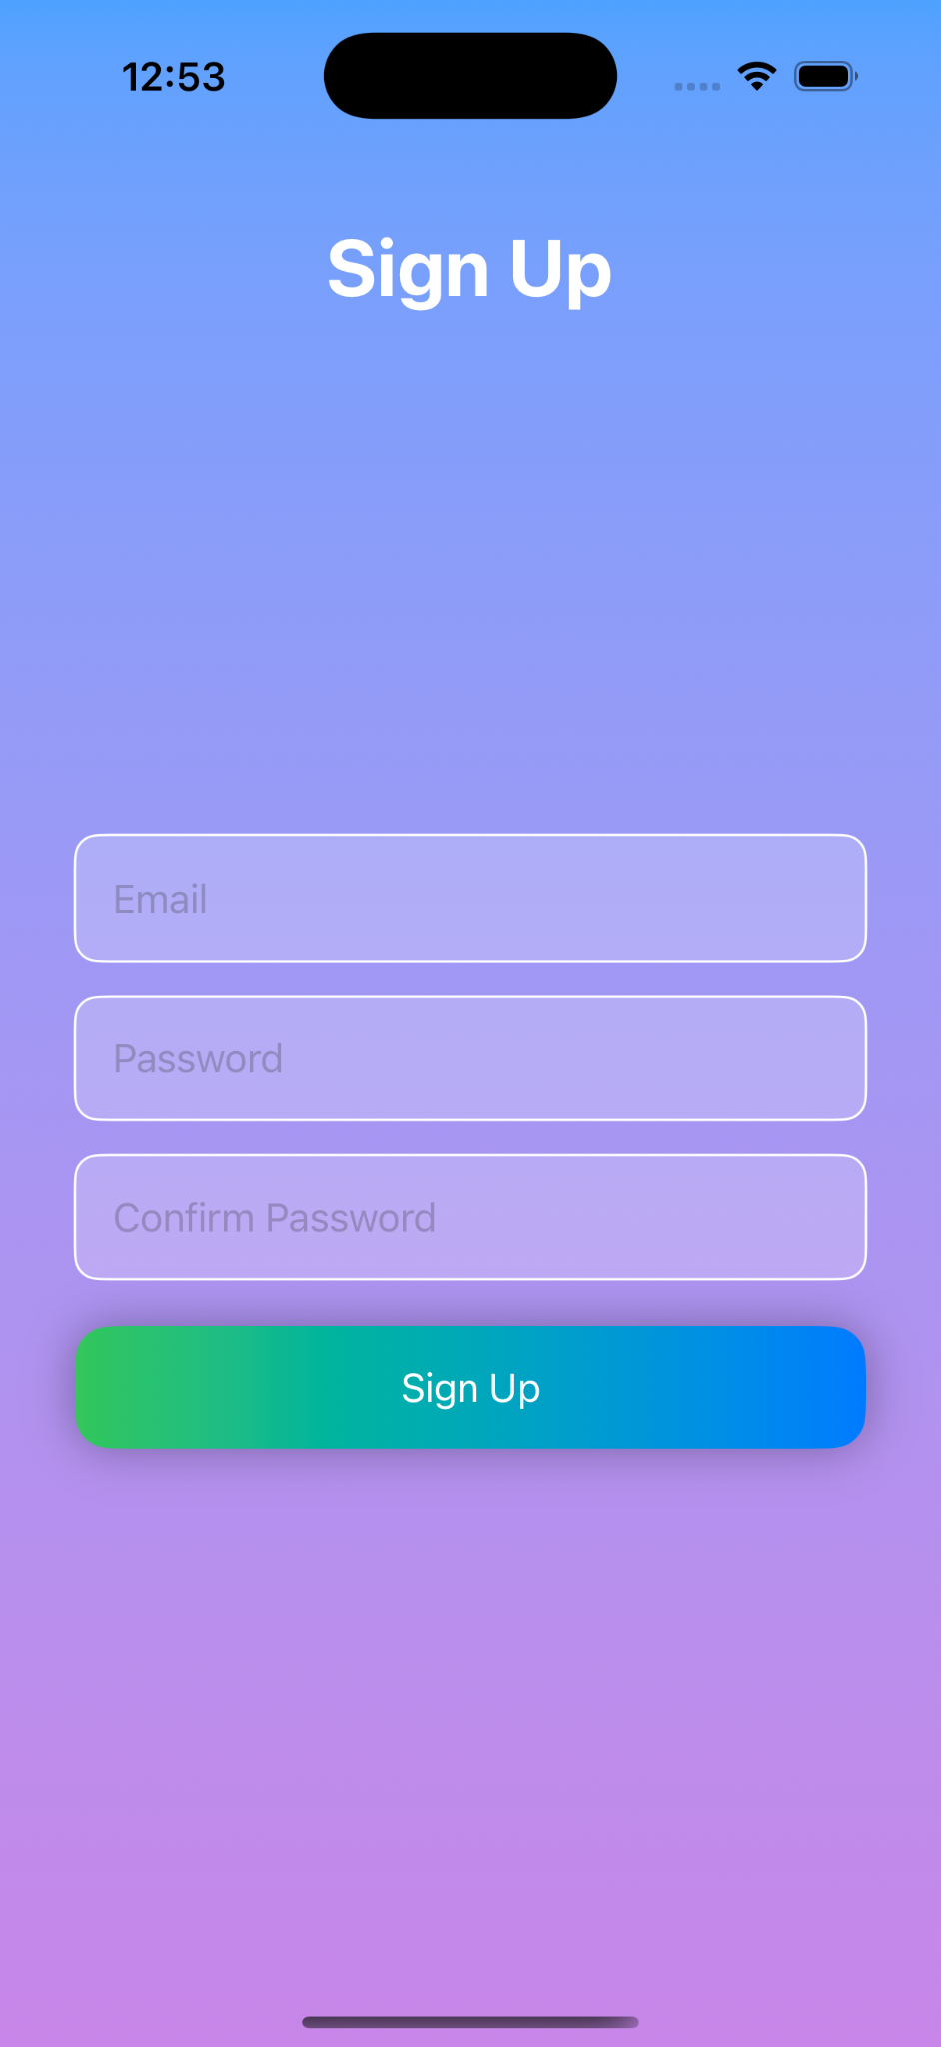

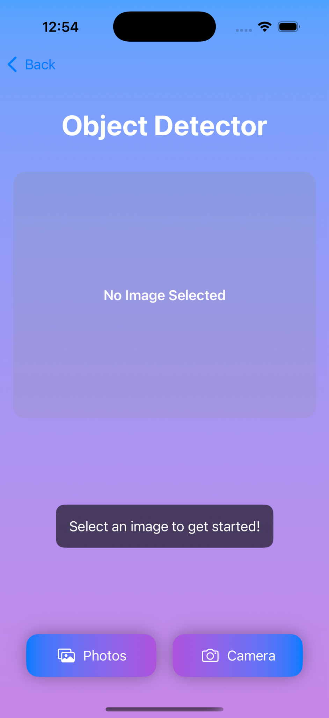
Sign Up page: (New User)

Slide 5
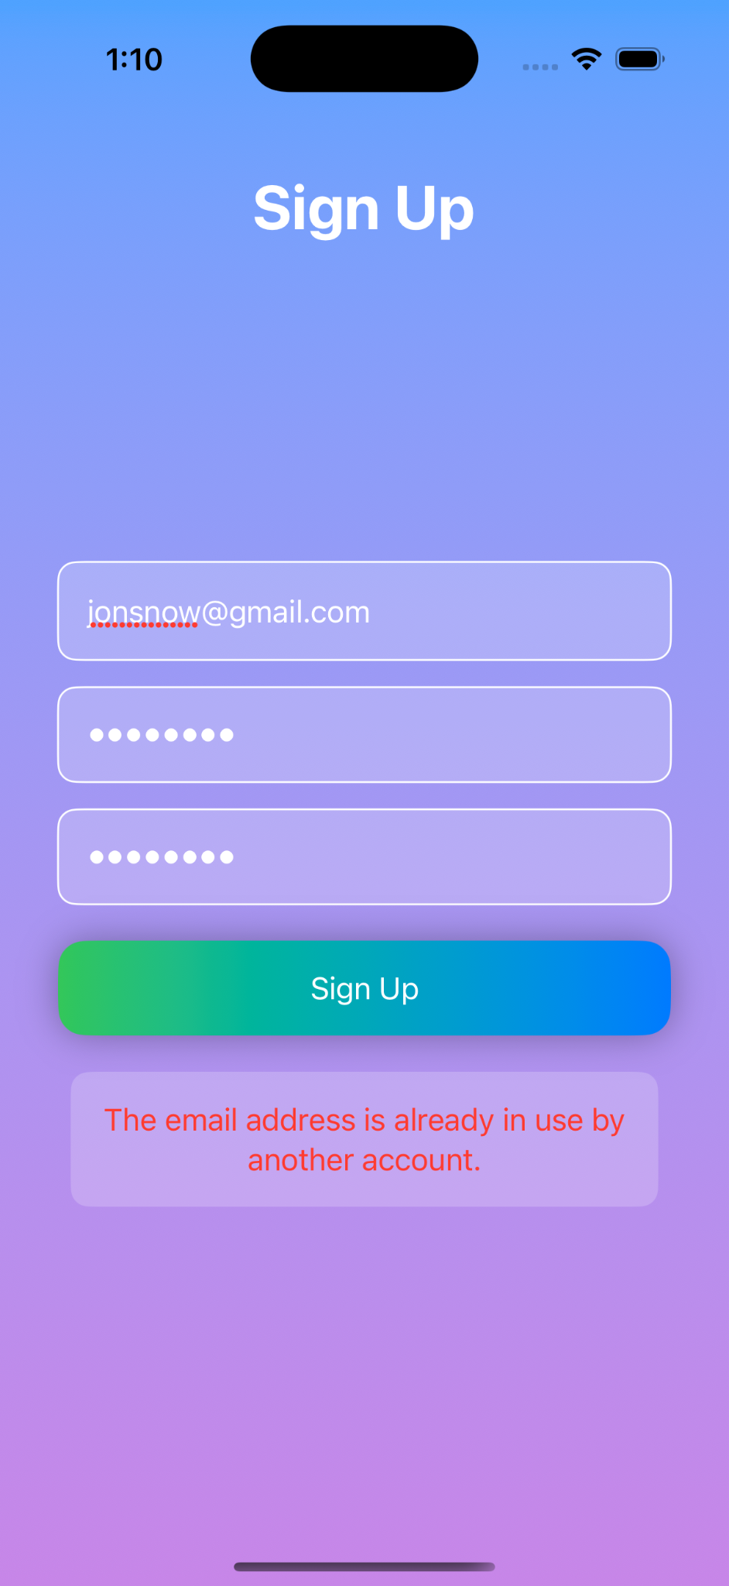

Sign Up page Alerts:

Slide 6


Login page: (Existing User)

Slide 7

Login page Alert:

Slide 8
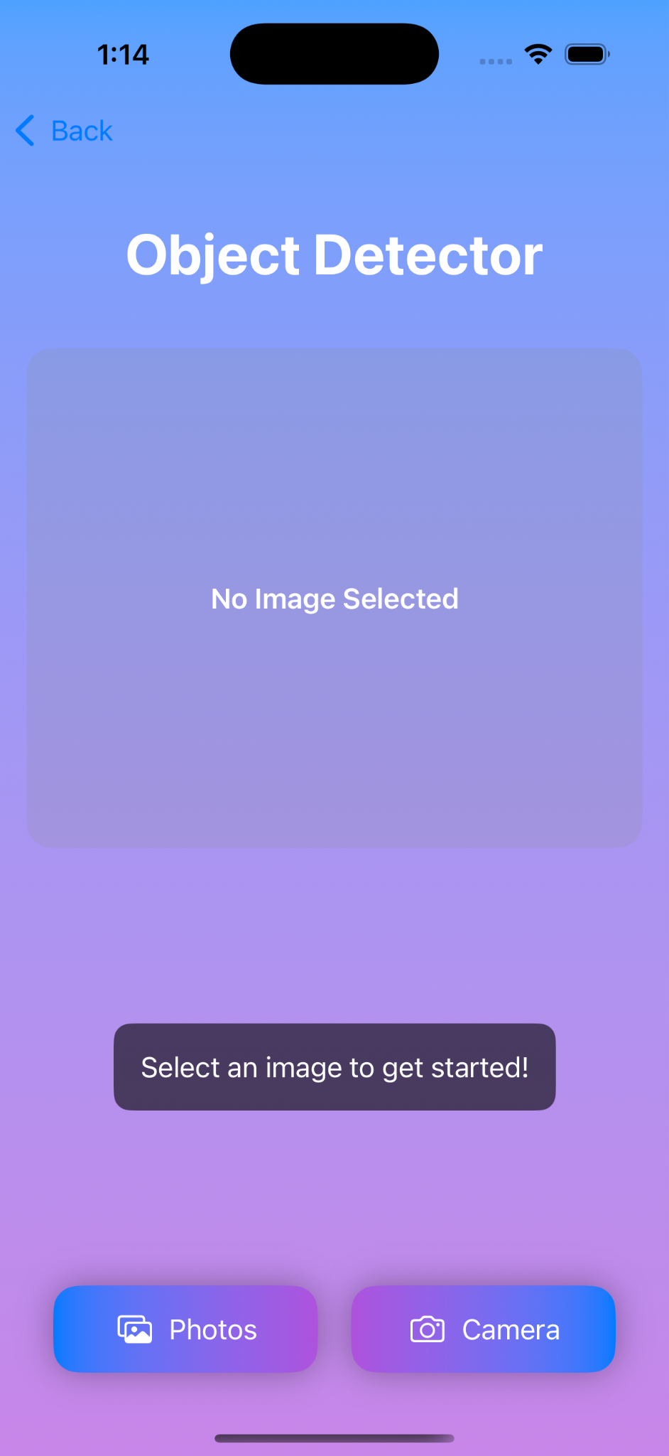
Main Page:

Slide 9
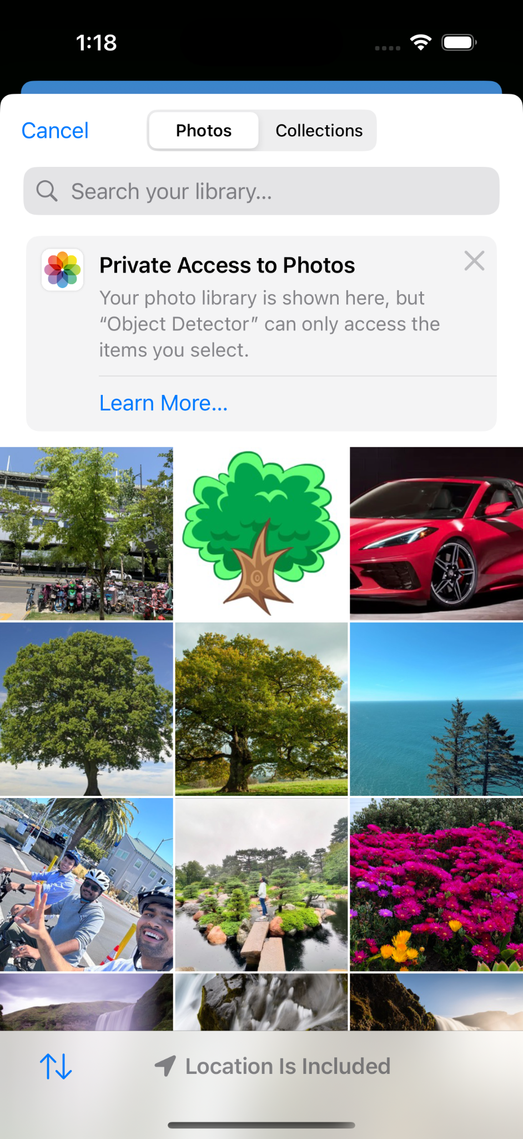


Slide 10
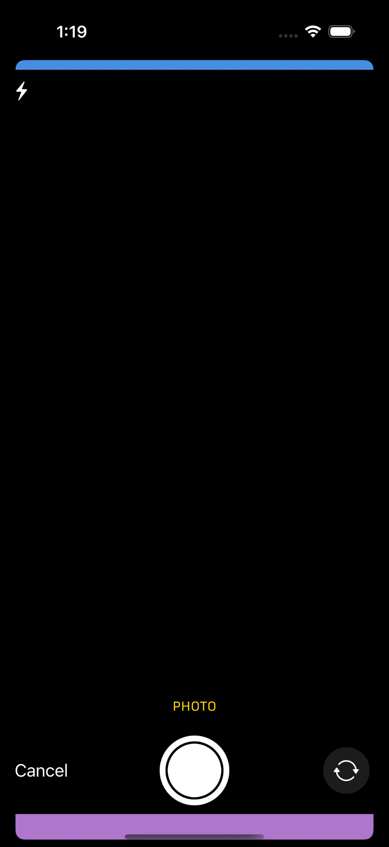

Slide 11
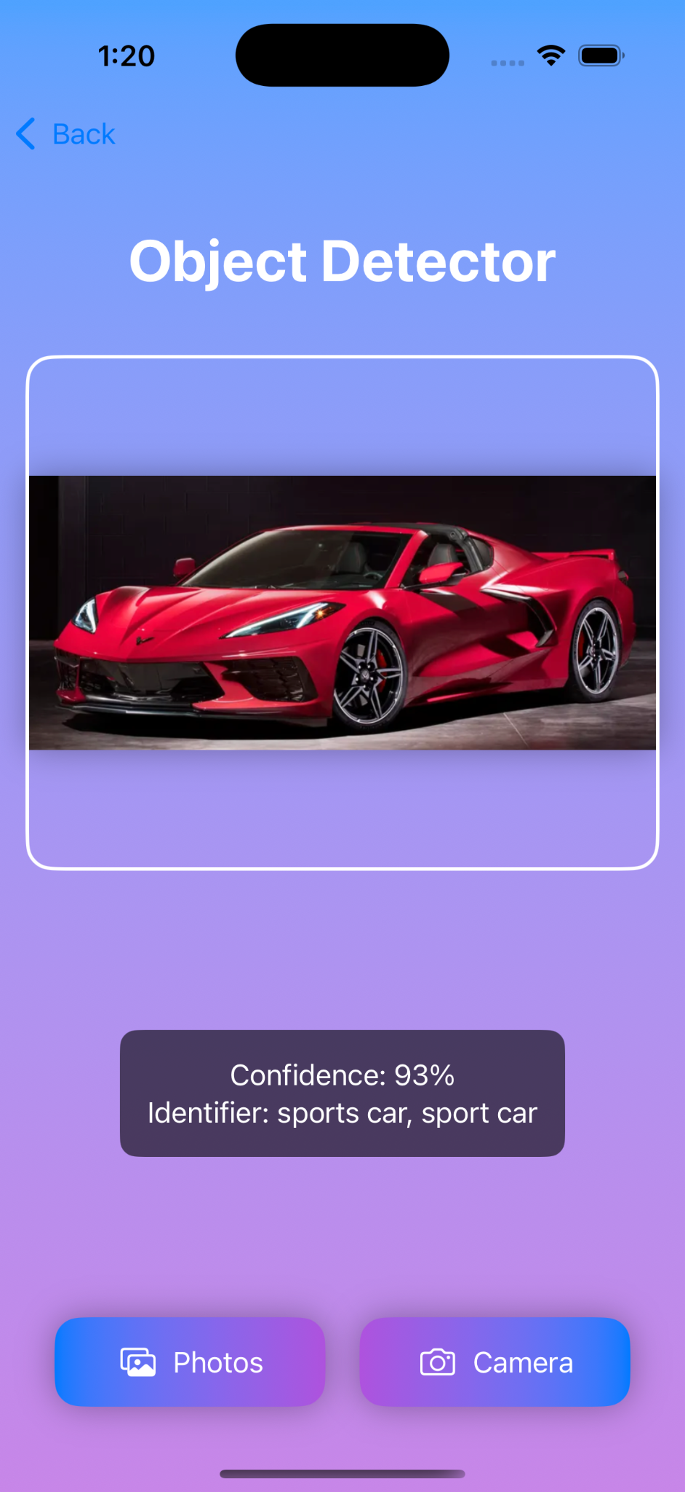
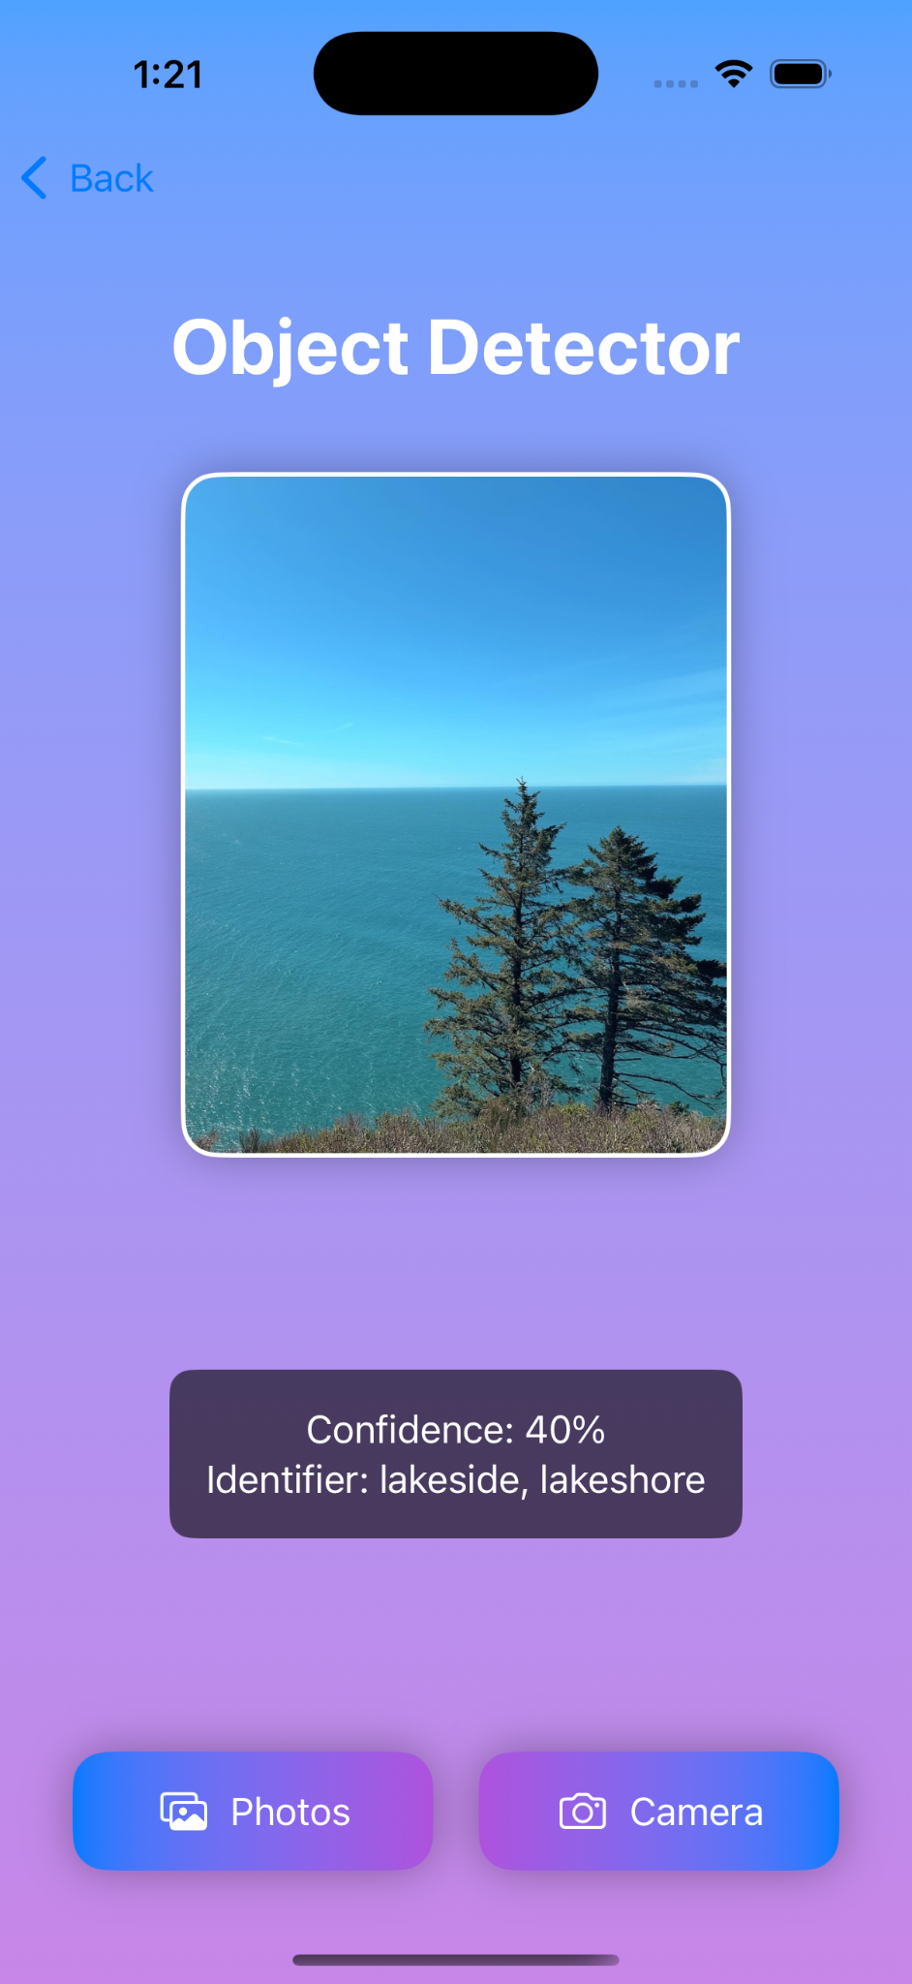

Slide 12

Google Firebase Authentication

